Slide 1
Web Fundamentals Project
1/ How does the web work?
2/ What do you need to be a web developer?
3/ Why did you choose to learn web development?

Slide 2
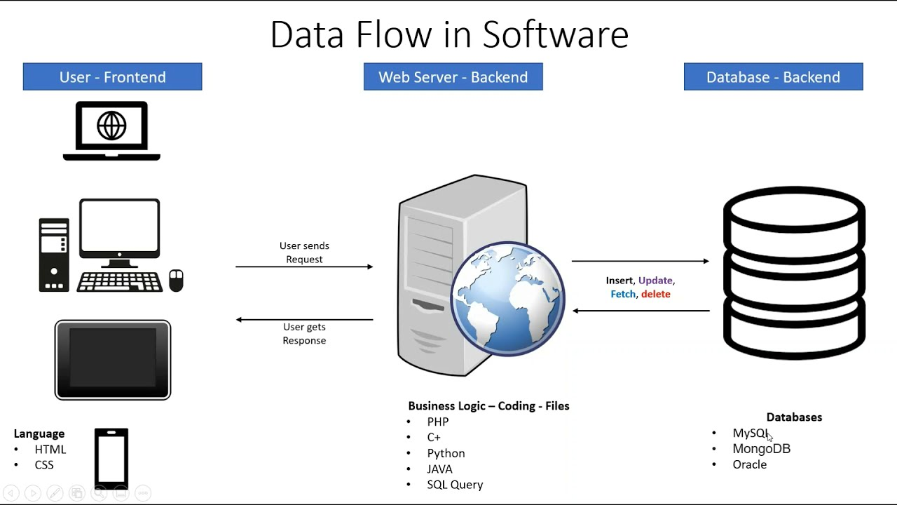
1/ How does the web work?

Slide 3
2/ What do you need to be a web developer?
To become a Web Developer, you should have an understanding of HTML, CSS, and JavaScript. It's also recommended to learn about CSS and CSS frameworks. Developing these fundamental web development skills will give you the foundation and logic for communicating with programming languages.

Slide 4
3/ Why did you choose to learn web development?
There Are Web Dev Jobs Available
A Great Income
No Wasted Time in Learning How to Code
I Can Work From Anywhere
I Can Work at an Awesome Tech Company
There Are Always Freelance Opportunities
It’s Creative and Fun

